Slide 1
Quick Sort
Programming – Code Design & Data Structures

Slide 2
Contents
Quicksort
Implementation
Visualization
Performance

Slide 3
Quick Sort
Quick sort is a ‘divide-and-conquer’ algorithm
The basic ‘divide-and-conquer’ approach is to:
Divide: split the array into sub arrays around index q, all values < q go in one array, values > q in the other
Conquer: sort the two sub arrays via recursive calls to sort
Combine: in quick sort, sub arrays are sorted in place so no work is needed to combine them

Slide 4
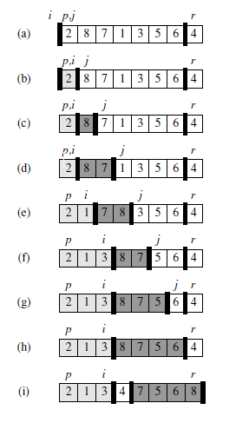
Quick Sort
So far, none of the elements have been placed in either of the first two partitions. A[r] is selected as the pivot value
A[j] is compared with A[r]. 2<4, the smaller partition (i) grows to include 2
j is incremented and A[j] compared to A[r]. Value 8>4, the larger partition grows to include 8
The larger partition grows to include 7
The values 1 and 8 are swapped, and the smaller partition grows
The values 3 and 7 are swapped, and the smaller partition grows
The larger partition grows to include 5
The larger partition grows to include 6
The pivot element (r) is swapped so that it lies between the two partitions
The two partitions A[p..i] and A[i+1..r] have been processed. The partitions will then be recursively sorted using quick sort until the whole array is sorted

Slide 5
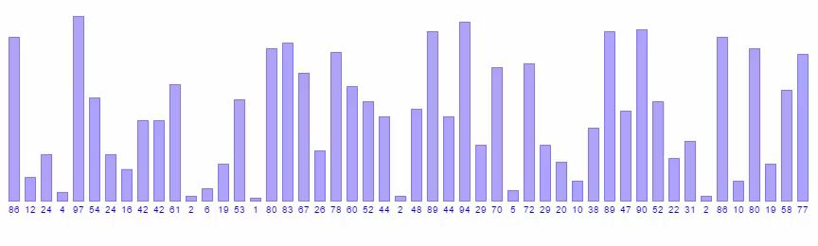
Visualization

Slide 6
Implementation
The key to the algorithm is the Partition function, which rearranges the sub-array A[p..r] in place
x = A[r] used as a pivot element around which to partition the subarray A[p..r]
def QuickSort(A, p, r)
if p < r then
q = Partition(A, p, r)
QuickSort(A, p, q-1)
QuickSort(A, q + 1, r)
def Partition(A, p, r)
x = A[r]
i = p – 1
for j = p to r – 1
if A[j] ≤ x then
i = i + 1
swap values A[i] and A[j]
swap values A[i+1] and A[r]
return i + 1

Slide 7
Performance
Worst-case running time of O(n²)
Expected running time is O(n log n)
Quicksort’s run time depends on the partition function, and whether its balanced or unbalanced
Determined by the pivot element used for partitioning
If the result of the partition is unbalanced, quicksort runs as slowly as insertion sort

Slide 8
Performance
Performance will depend on the pivot element selected, and on the data itself
A popular way is to choose the first (or last) element as the pivot
Only works if the data is random.
Will produce bad results if the data is already mostly sorted
A safe way is to choose a random element

Slide 9
Summary
Quicksort is a relatively simple sorting algorithm using the divide-and-conquer recursive procedure
It is the quickest comparison-based sorting algorithm
Comparison-based algorithms include bubble and insertion sort
Selecting a good pivot is crucial to quicksort’s speed

Slide 10
References
Cormen, T, 2009, Introduction to Algorithms, 3rd Edition, MIT Press
Cprogramming.com. 2017. Quick Sort. [ONLINE] Available at: http://www.cprogramming.com/tutorial/computersciencetheory/quicksort.html. [Accessed 27 April 2017].

